Slide 1
Import data into Mysql work bench

Slide 2
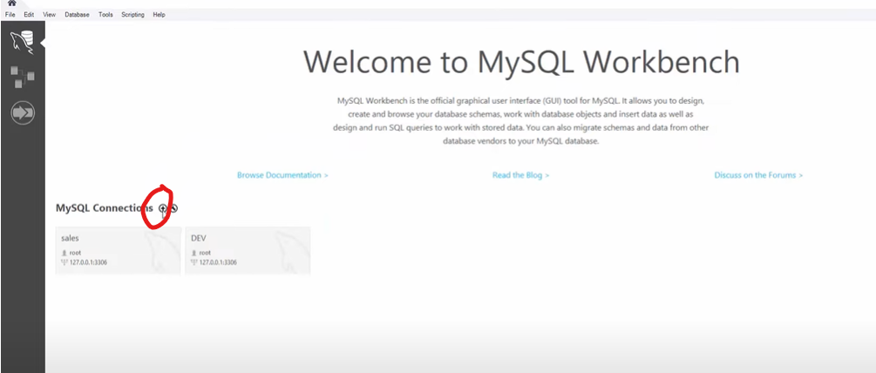
After you install Mysql Workbench click on plus to create a new connection

Slide 3
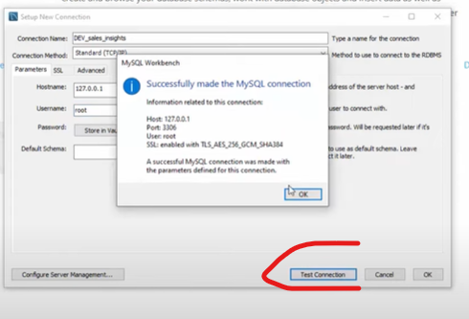
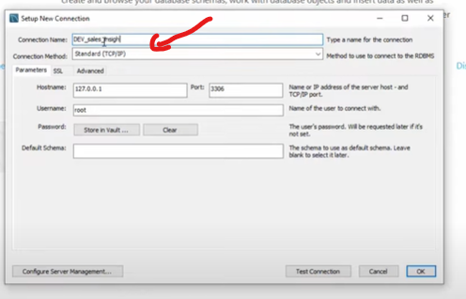
Just give name to ur DB and keep other settings as it is and then select “test connection”

Slide 4
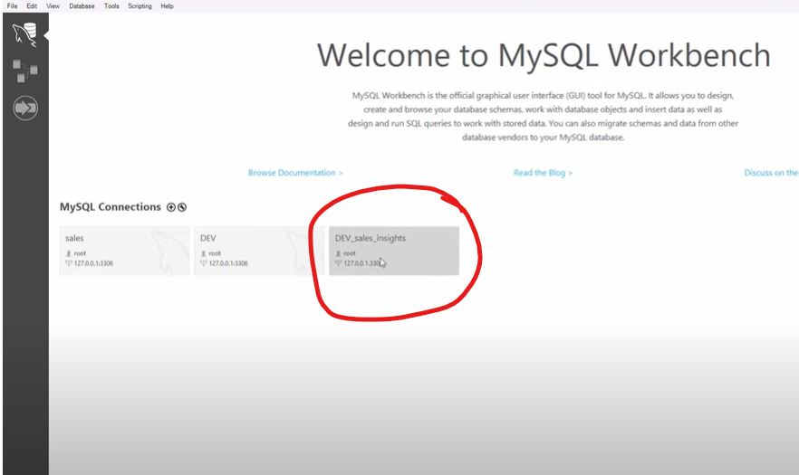
Now click on the connection

Slide 5
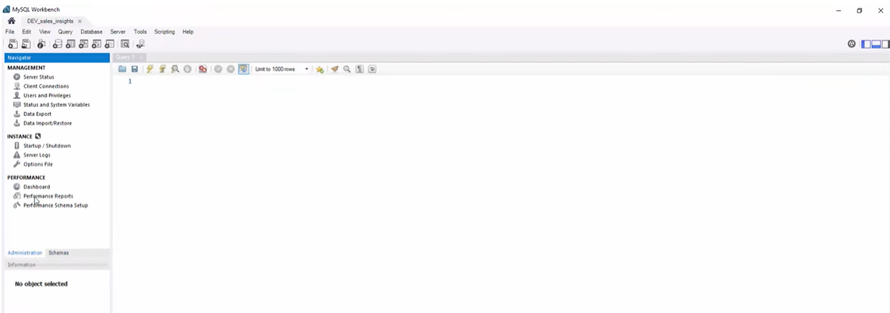
Work space

Slide 6
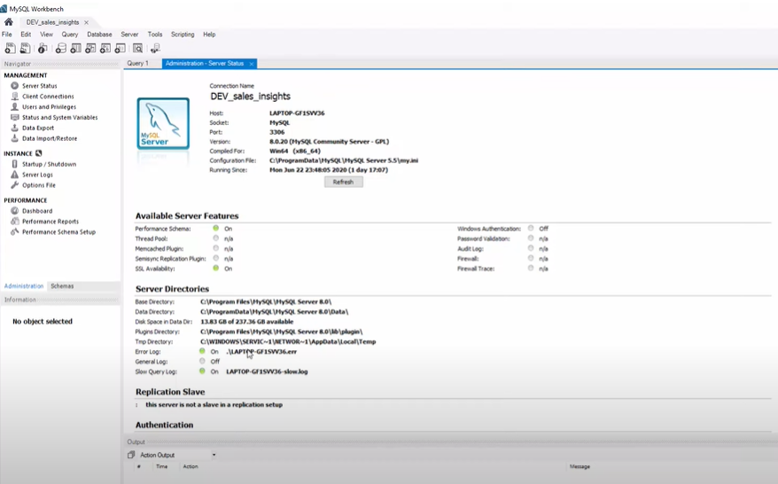
Check SQL server status

Slide 7
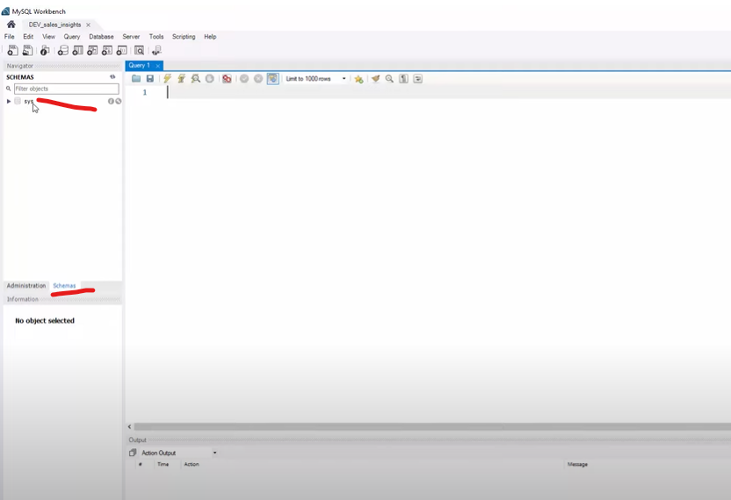
Goto schems you find default schemas called sys

Slide 8
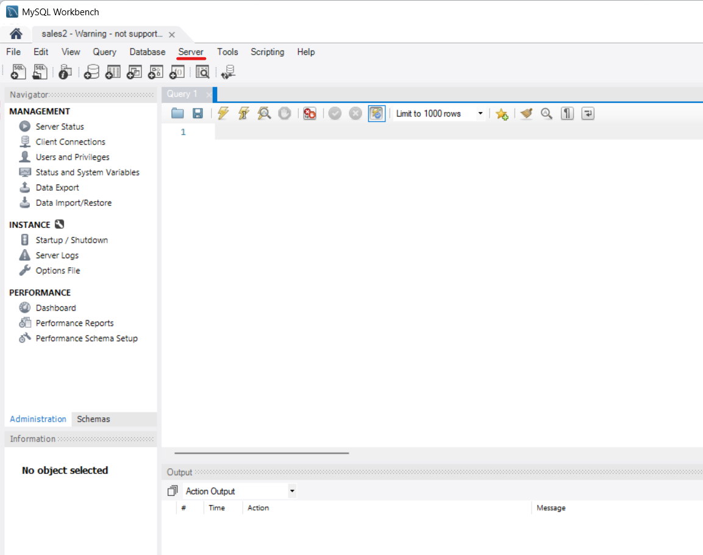
Goto server and select data import

Slide 9
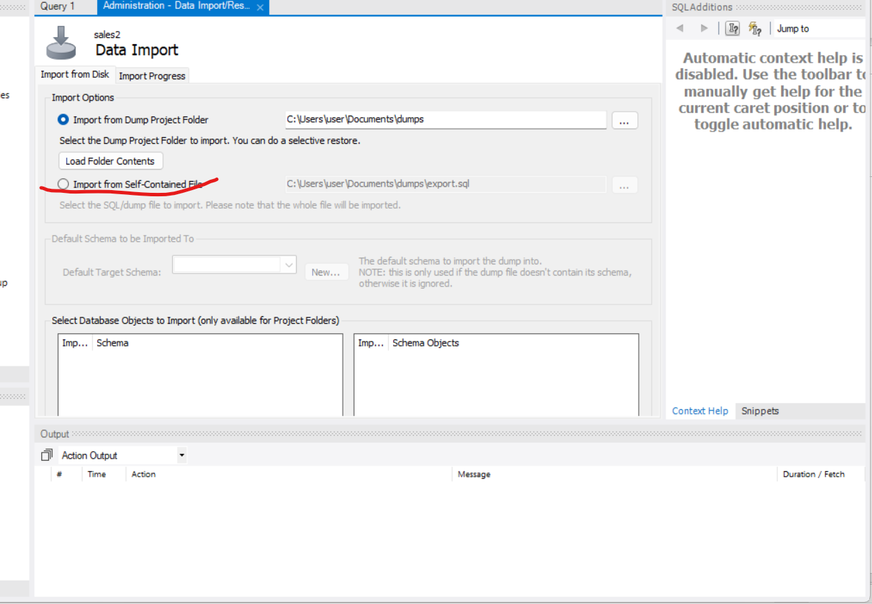
Select “Import from self contained file”

Slide 10
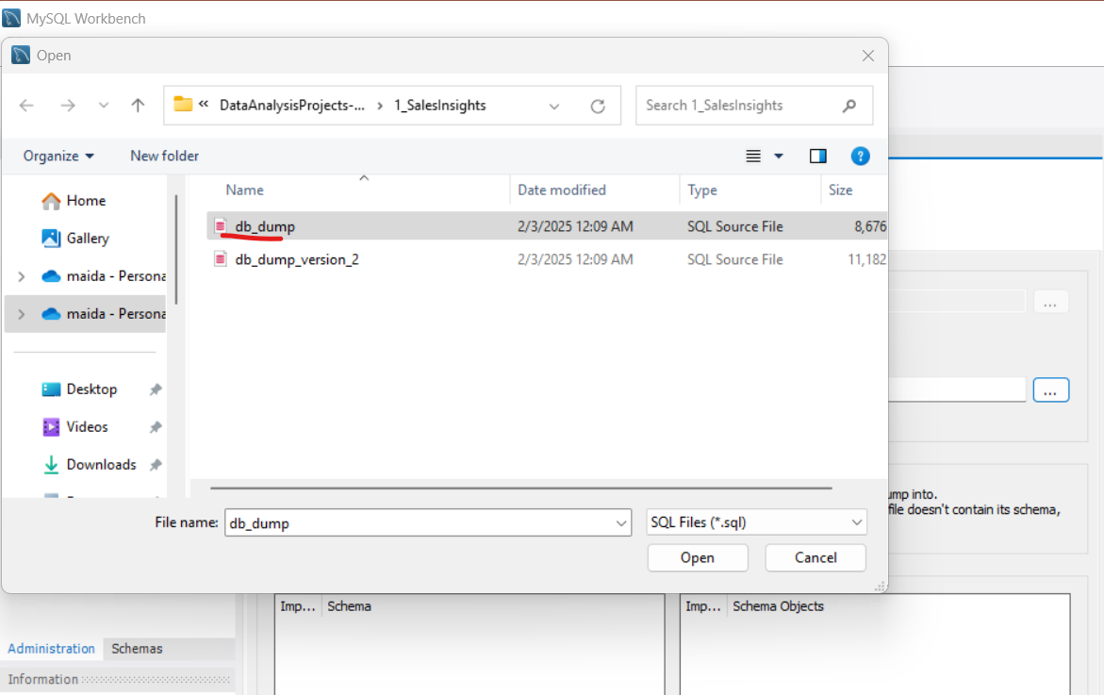
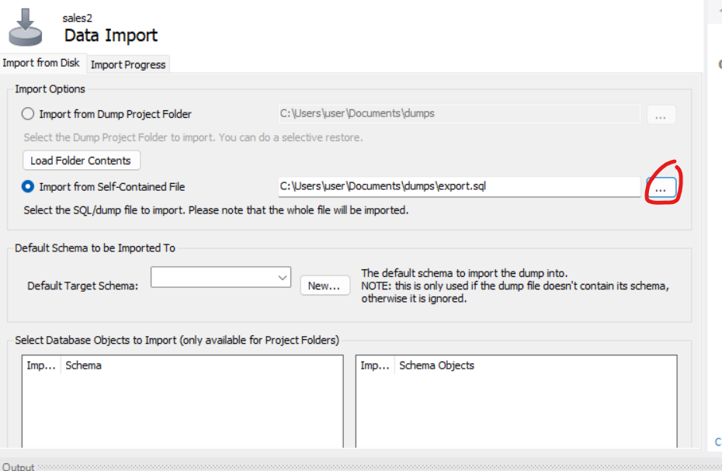
Click to find the location

Slide 11
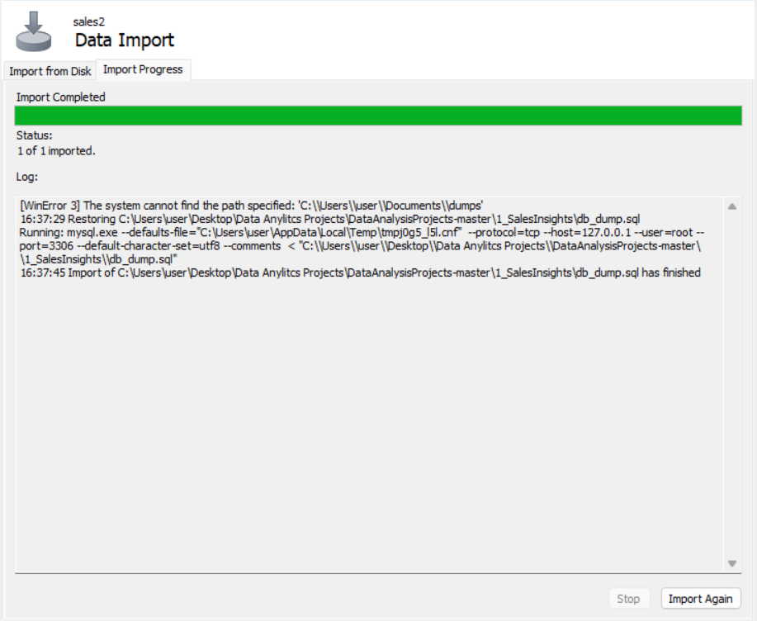
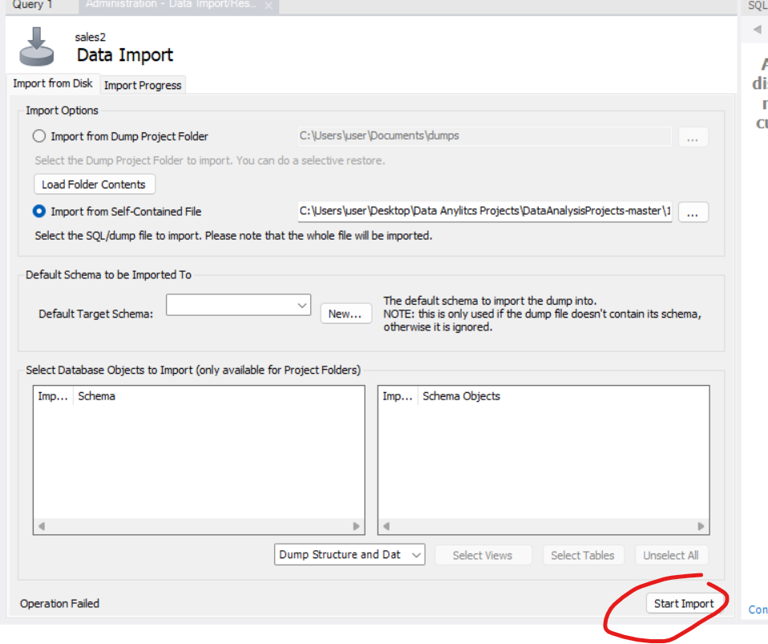
Click on start Import

Slide 12
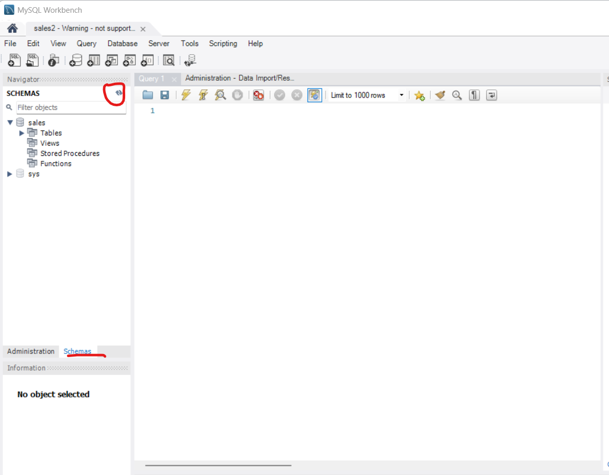
Goto schemas and click on refresh icon. Sales Database along with it s table would be shown

Slide 13
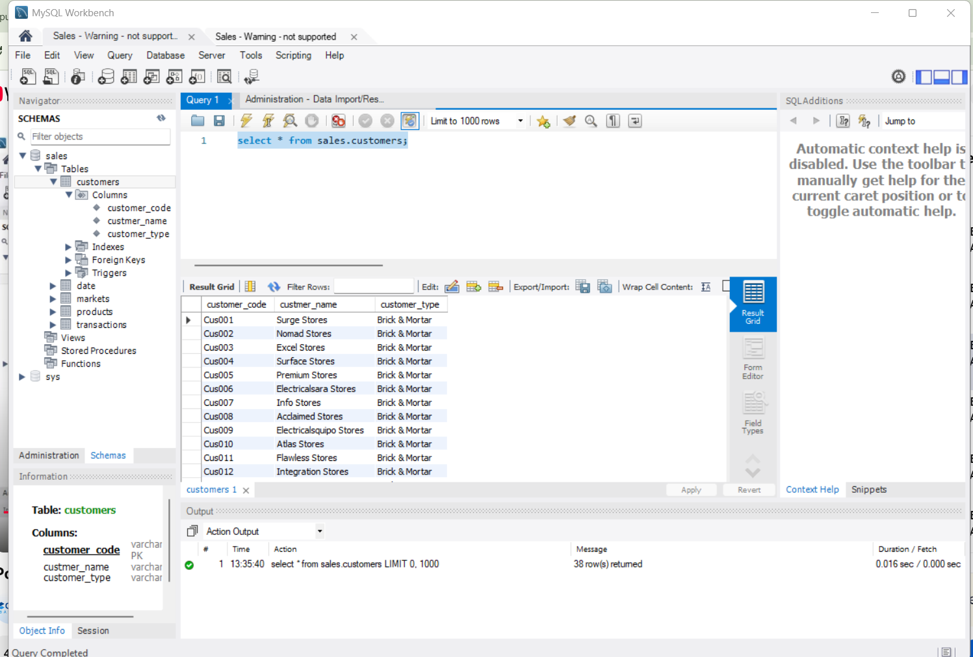
Now execute Queries

Slide 14
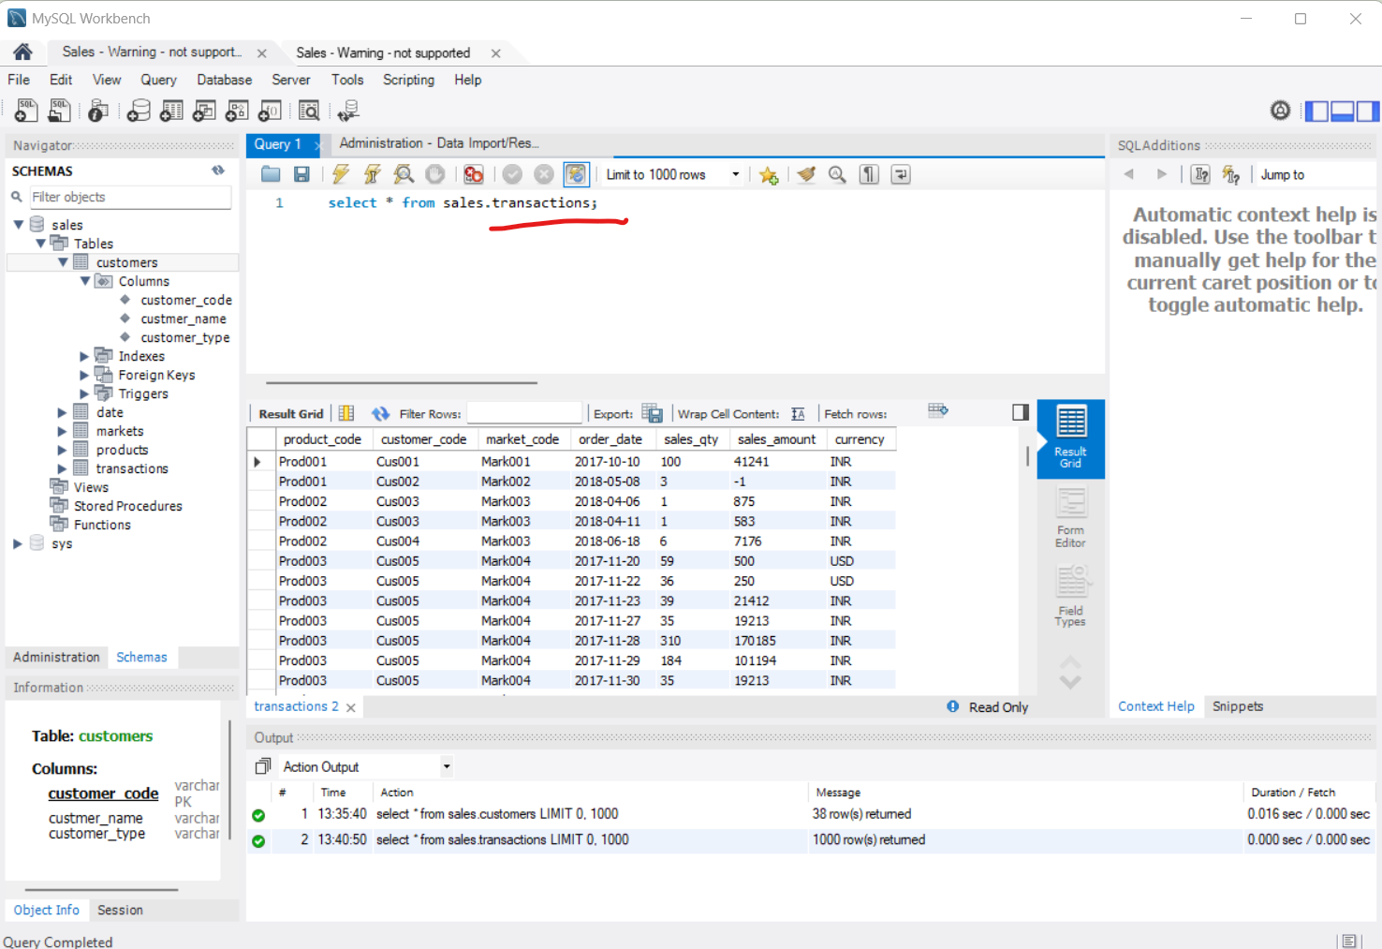
Sales.transactions

Slide 15
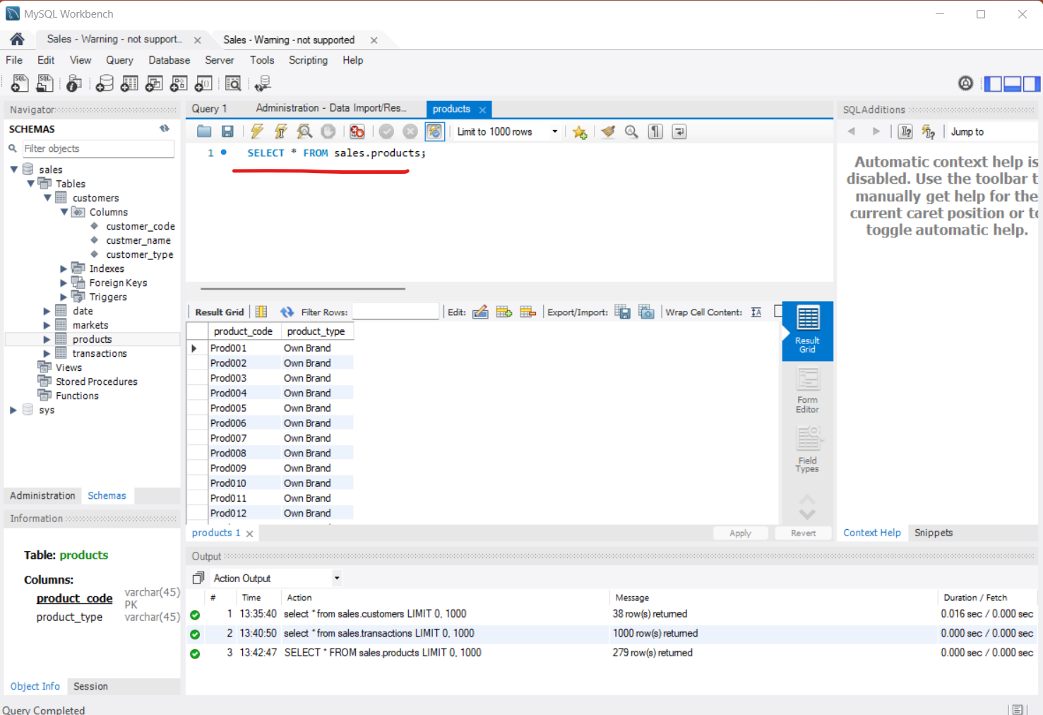
Right Click “Sales” and Select row

Slide 16
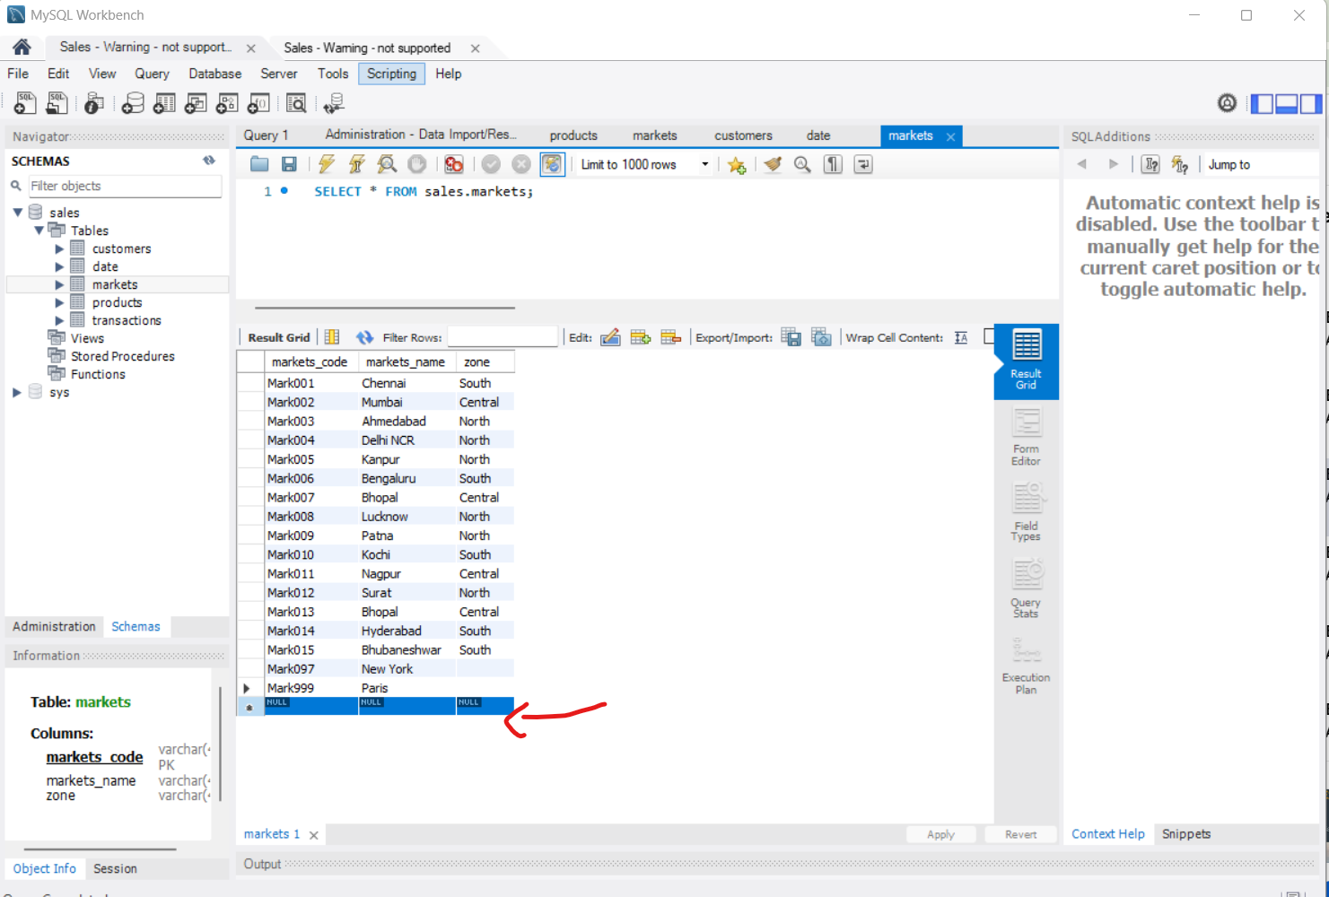
Null values

Slide 17
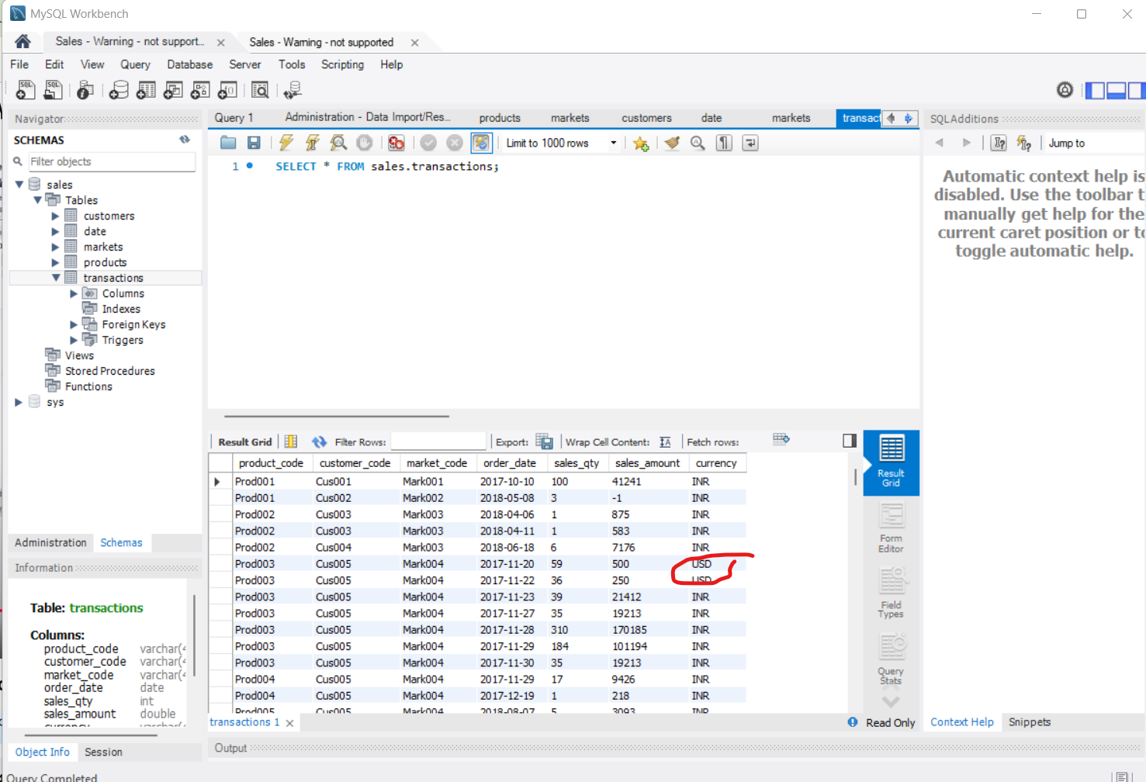
Rupees Analysis contain USD

Slide 18
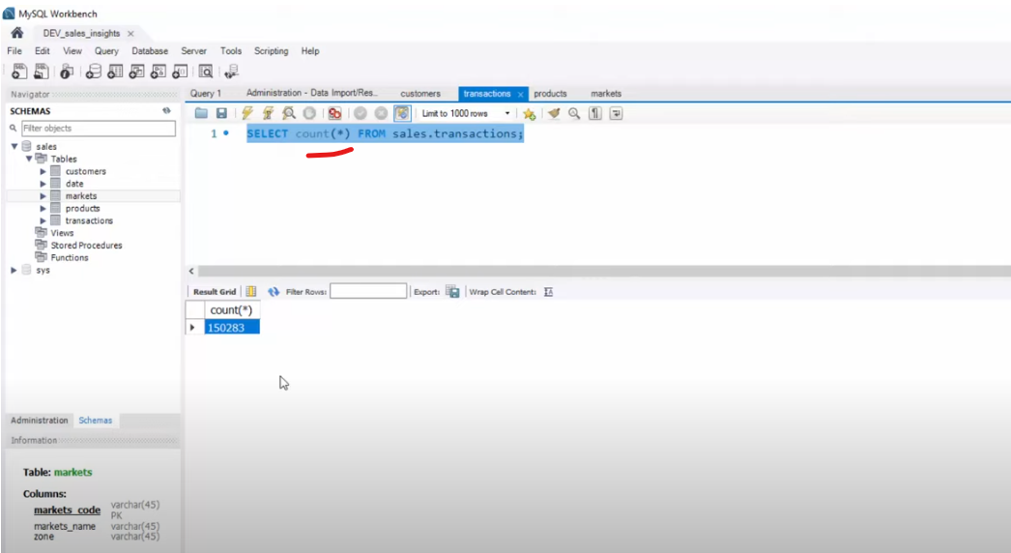
Count *= hundred and 50k database rows

Slide 19
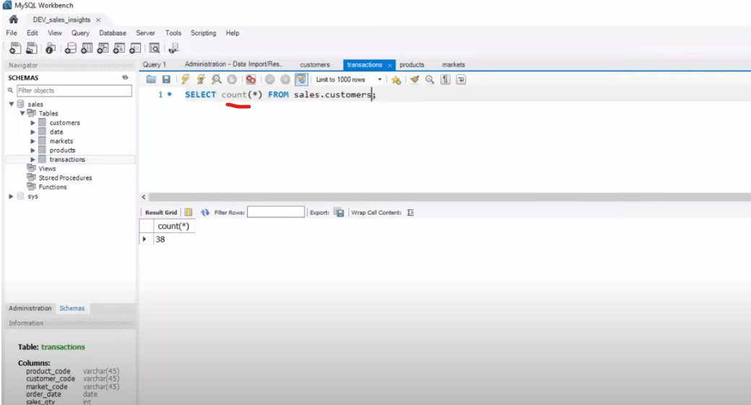
Count * Customer = 38 total district customers

Slide 20
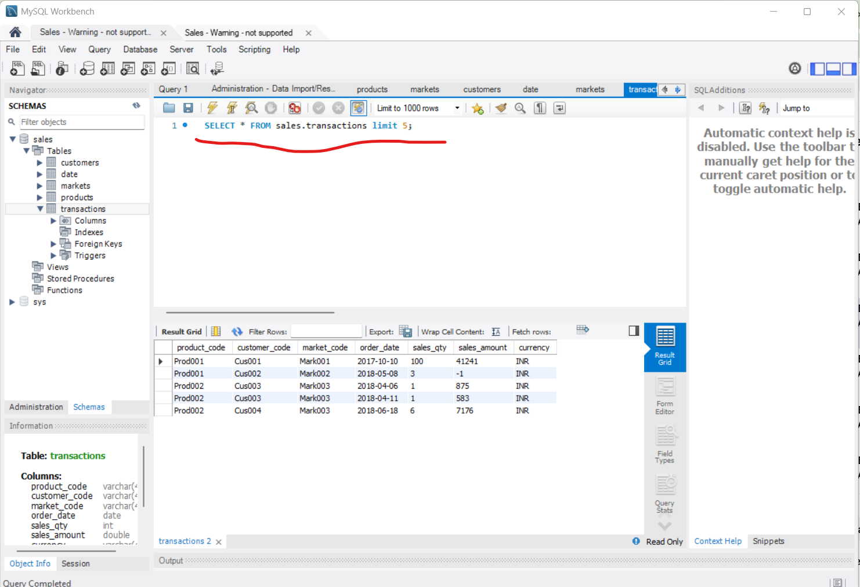
Limit Query

Slide 21
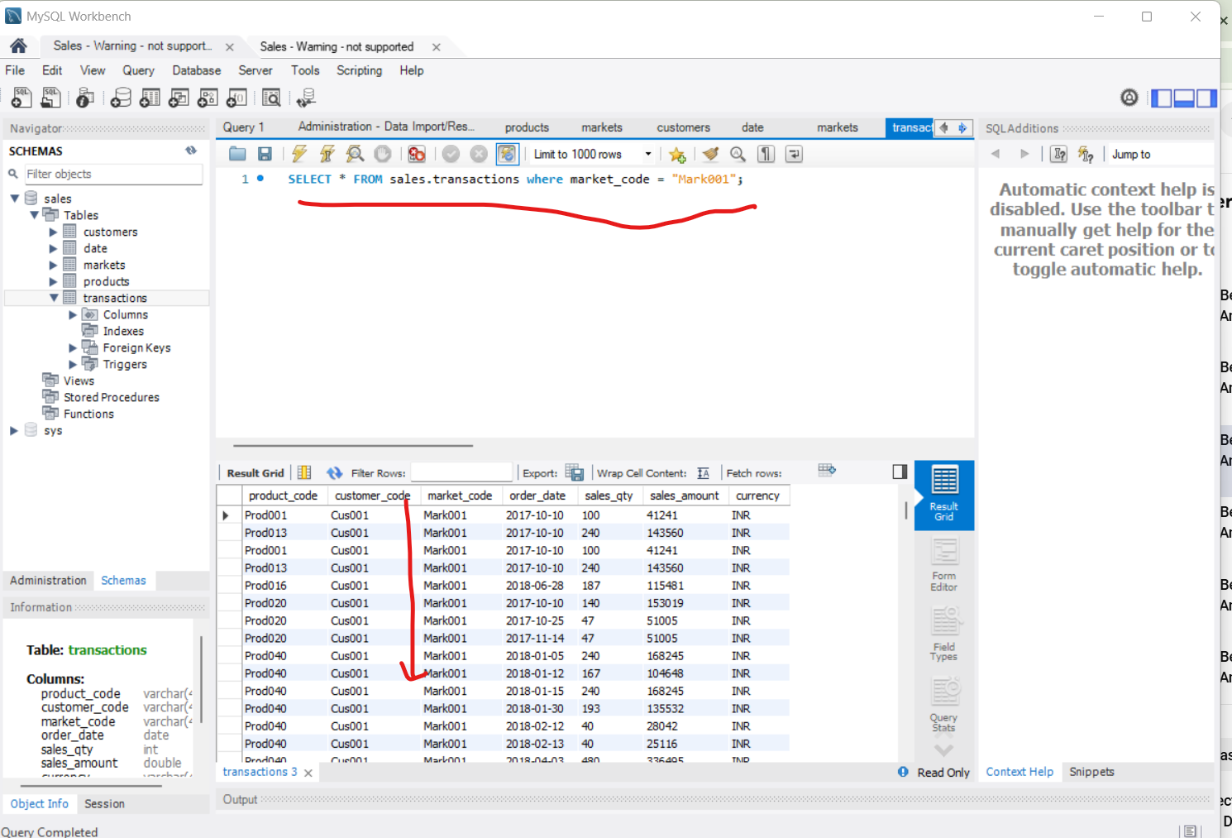
Print All the records where Market code = Mark001

Slide 22
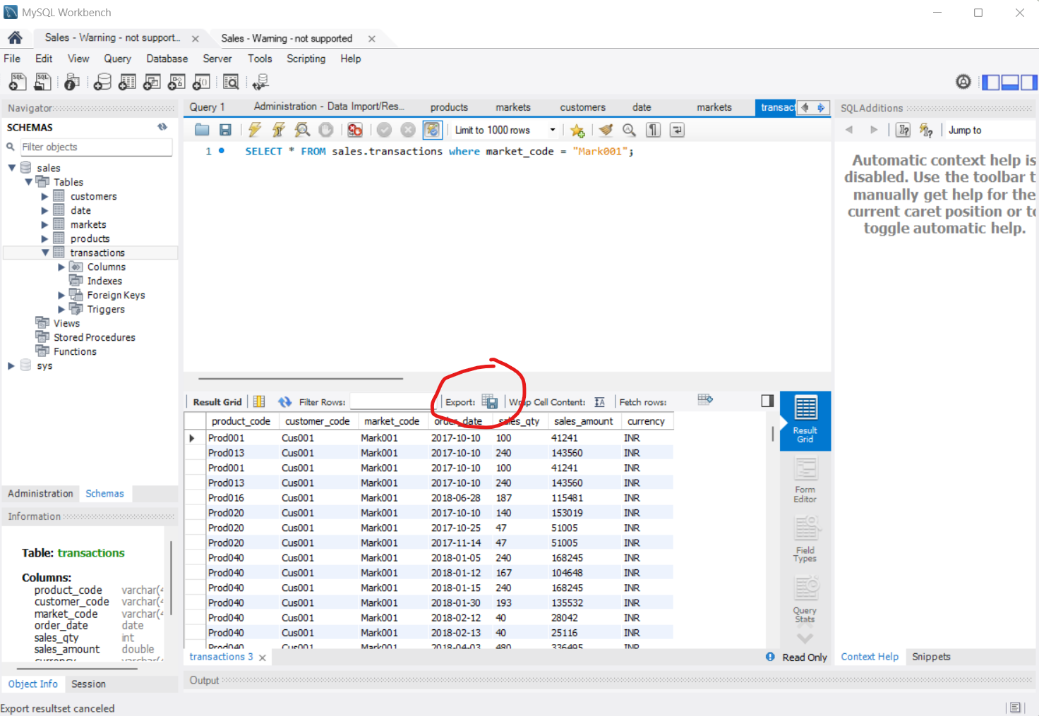
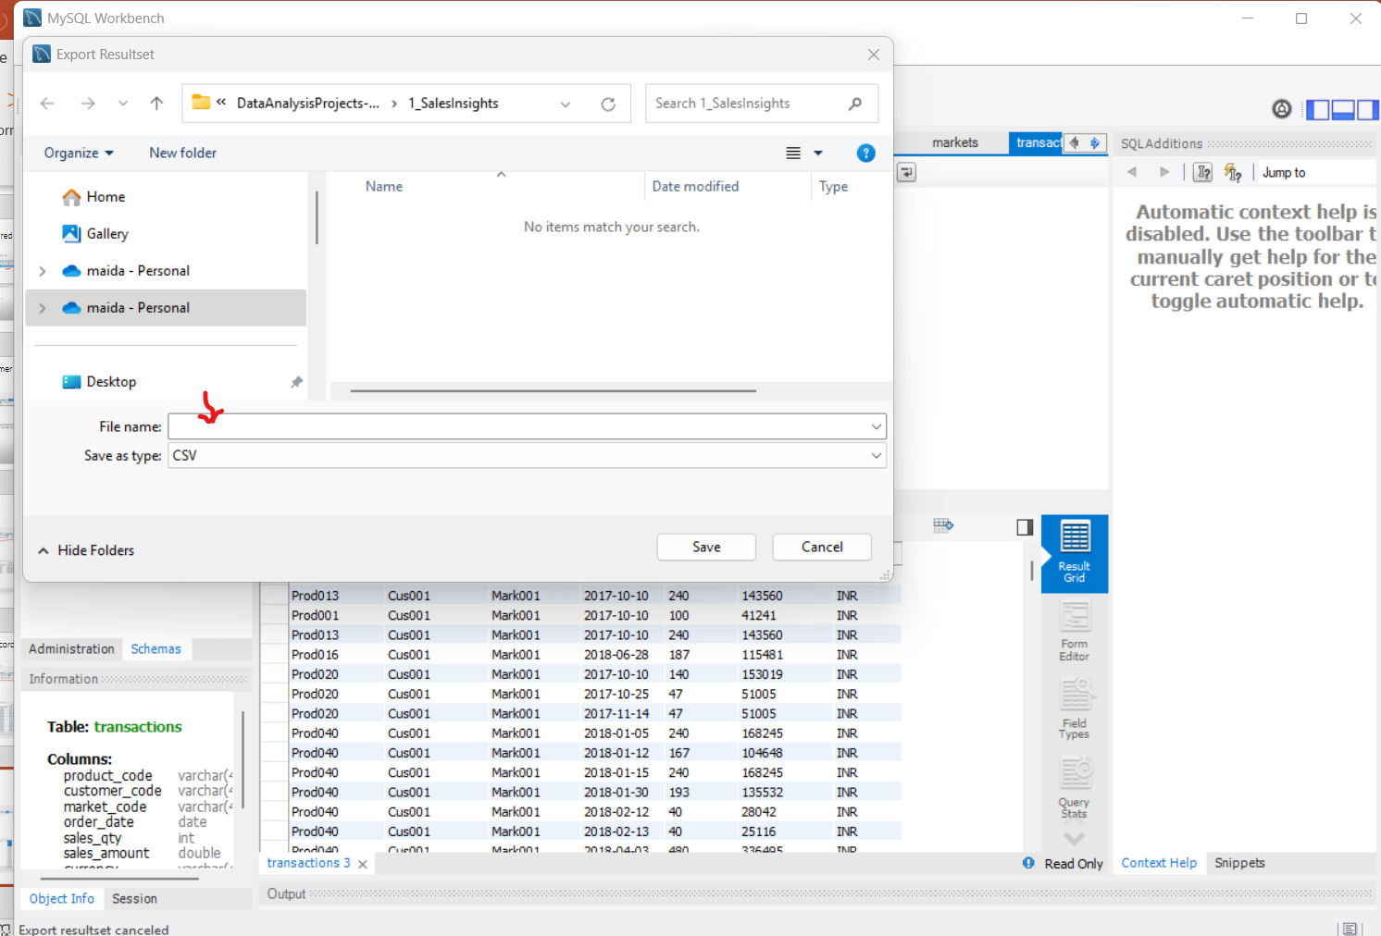
Export te results in te form of csv file

Slide 23
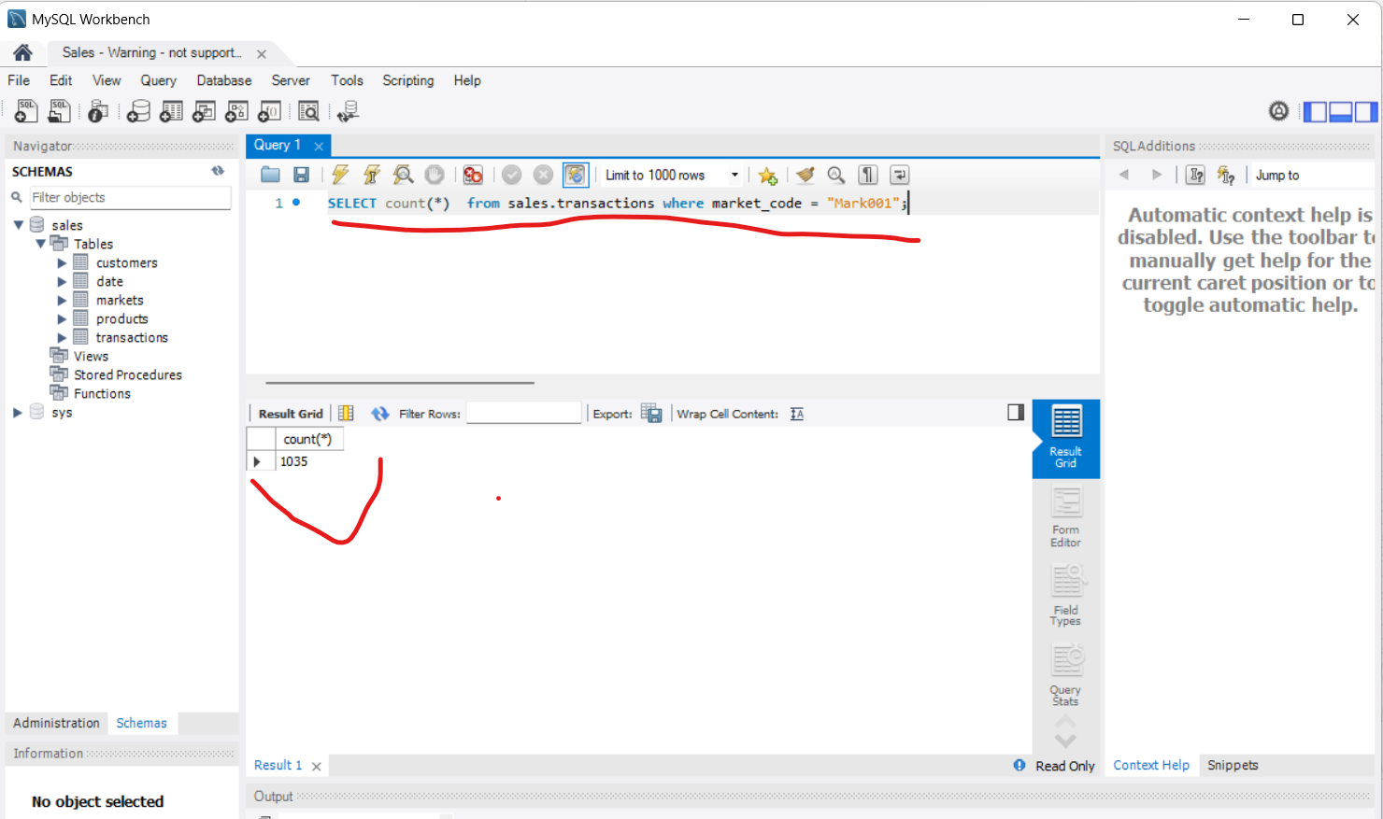
Distinct count of sales were market code is Mark001

Slide 24
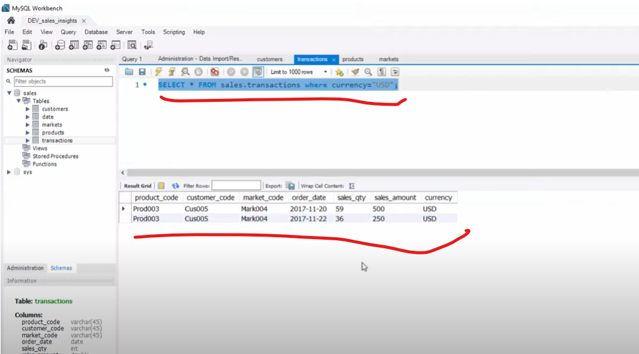
Sales transaction where customer paid in USD

Slide 25
Shows transactions in 2020 join by date table

Slide 26
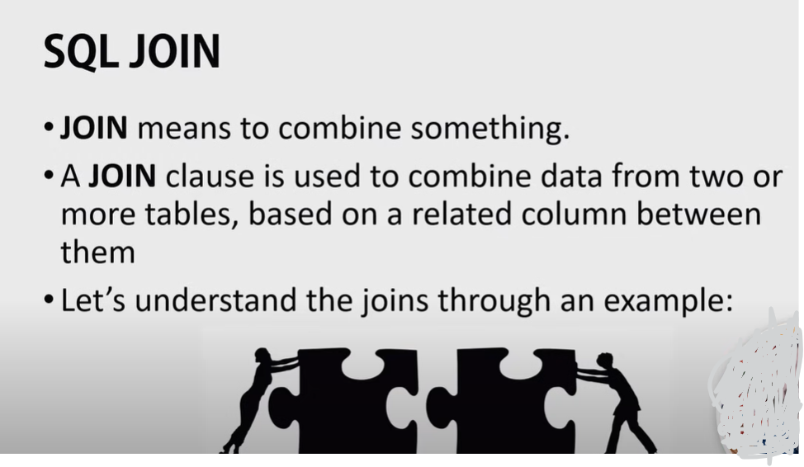
SQL JOIN

Slide 27
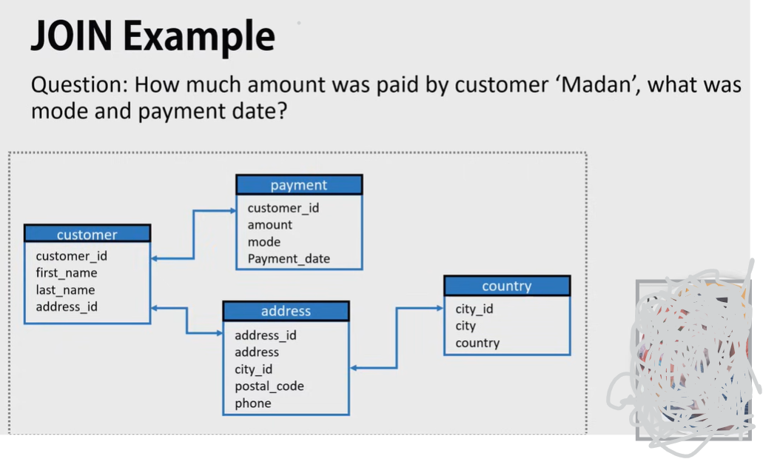

Slide 28
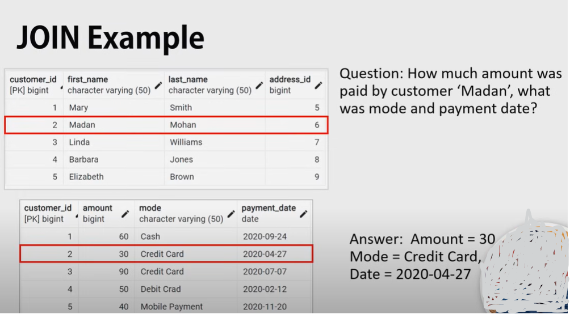

Slide 29
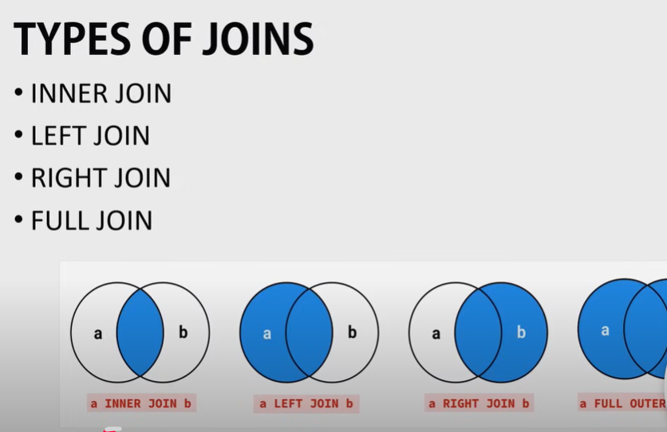

Slide 30
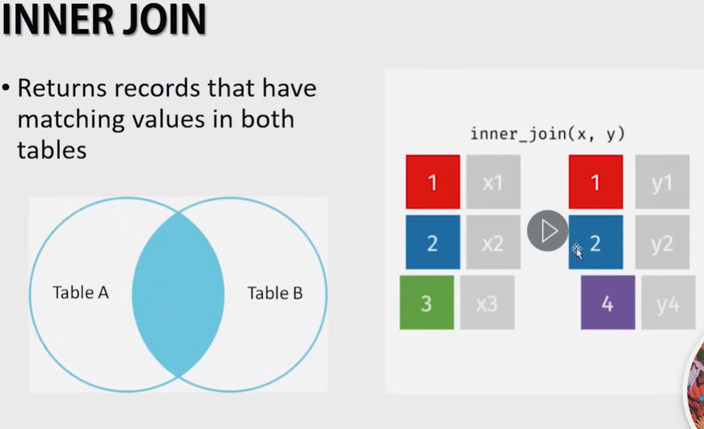
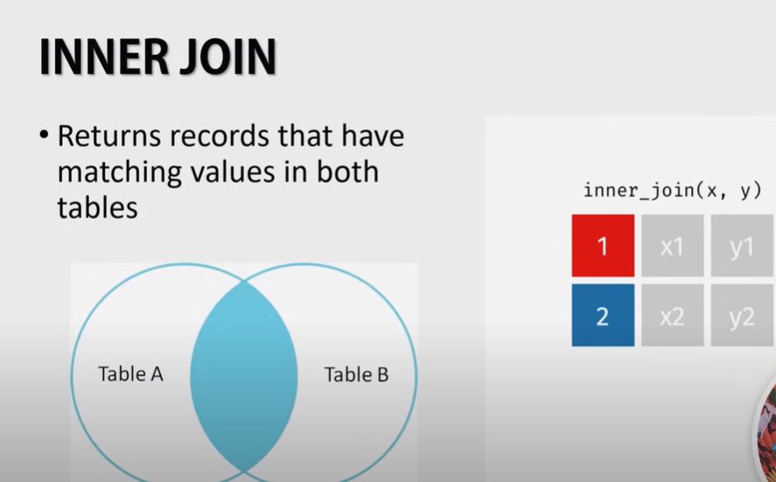

Slide 31
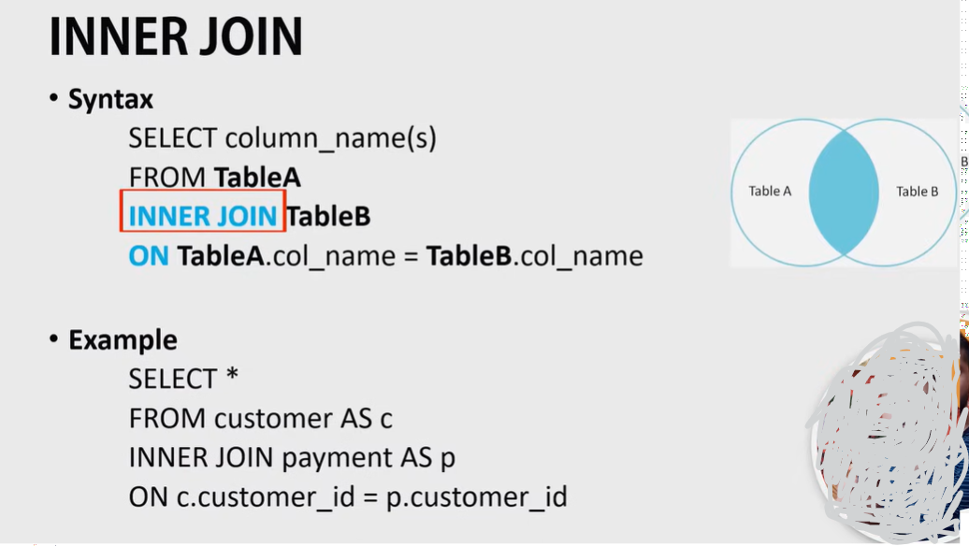

Slide 32
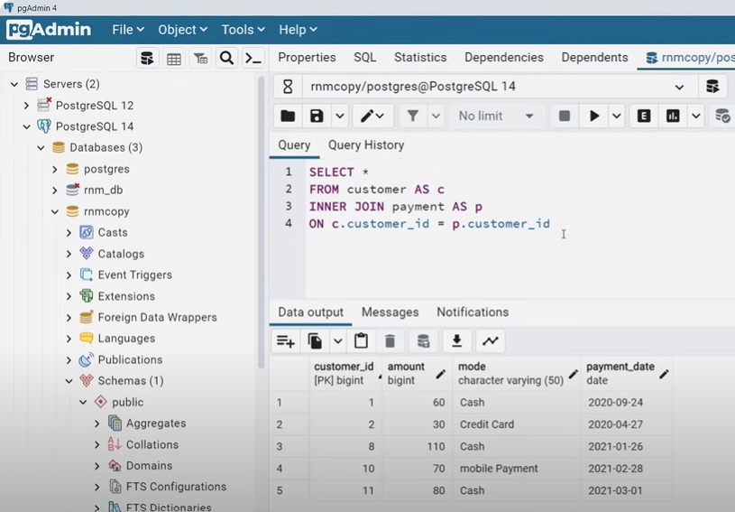
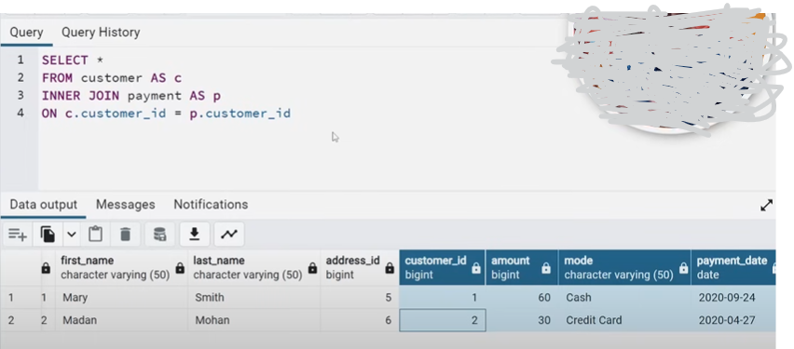

Slide 33
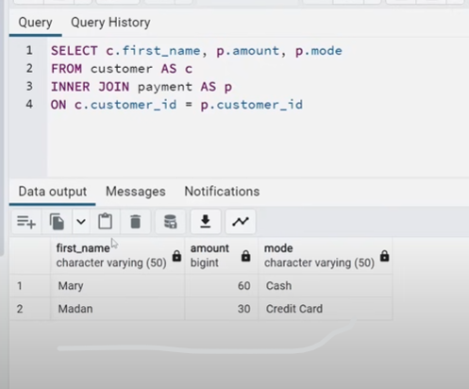

Slide 34
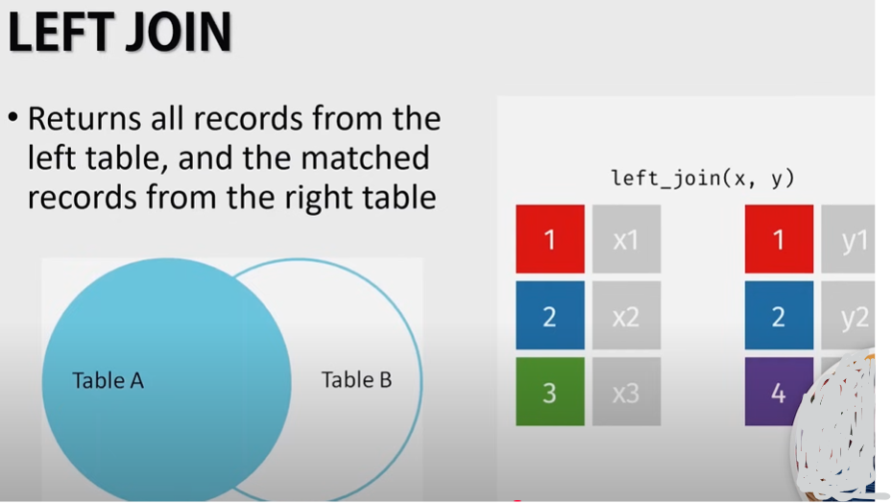
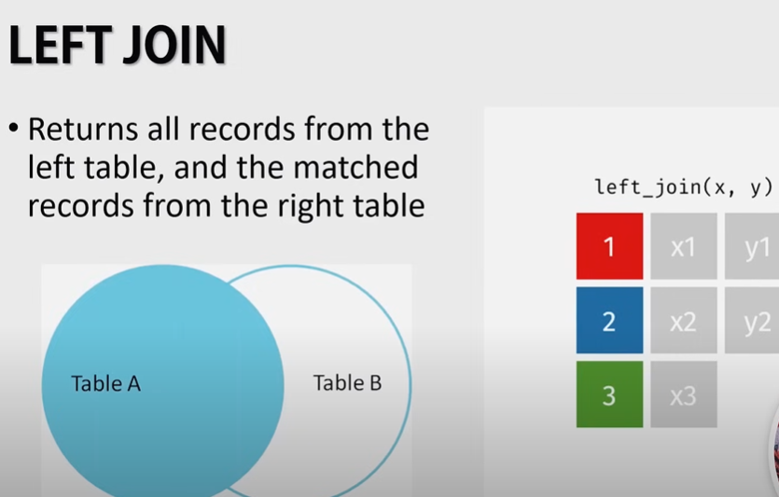

Slide 35
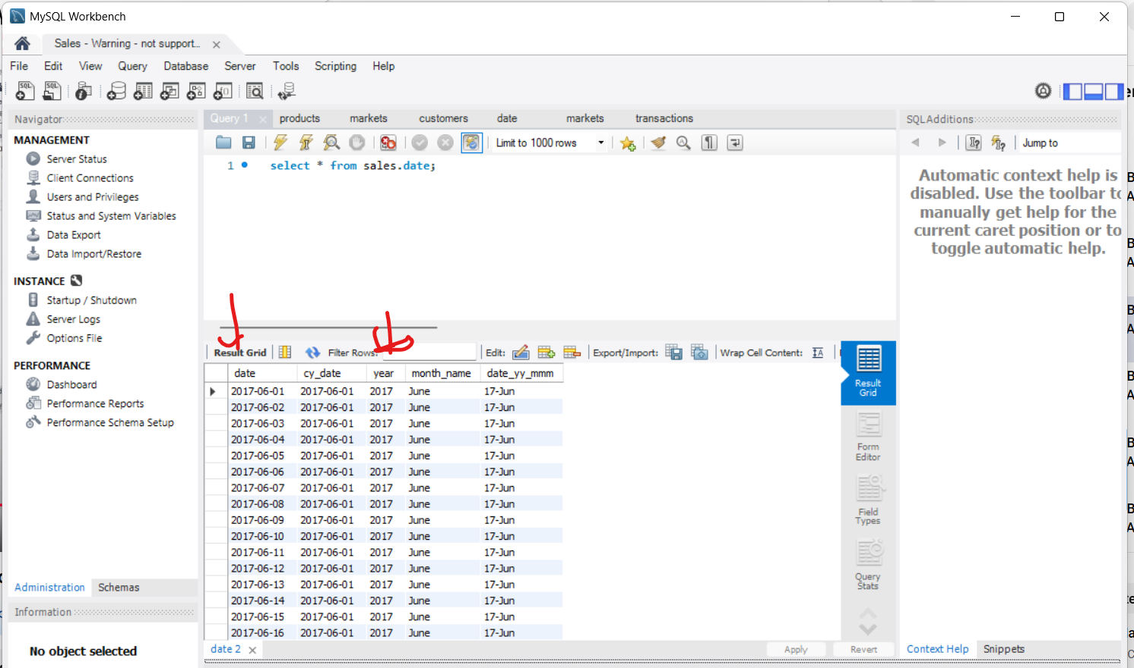
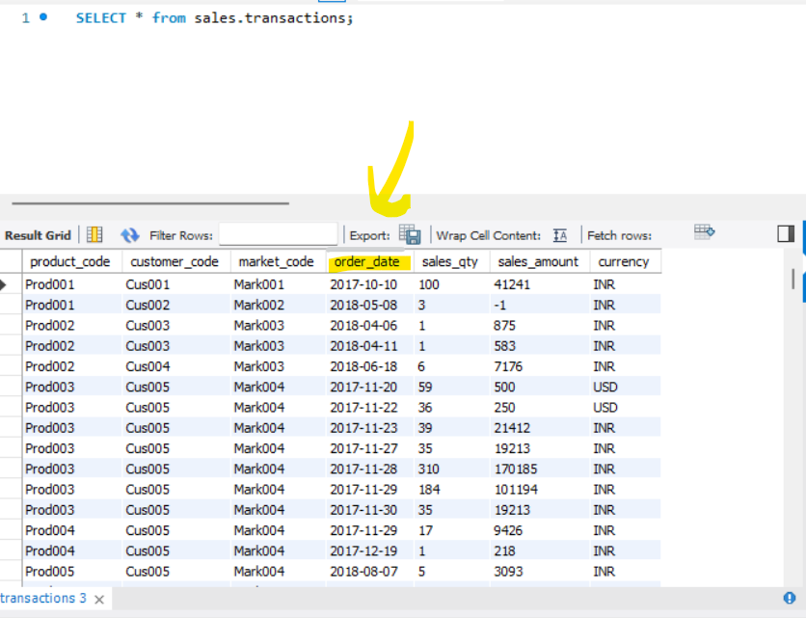
You want to Performs an inner join

Slide 36
Build a query for inner join as
“SELECT * from sales.transactions AS st INNER join sales.date AS sd ON st.order_date = sd.date; ”
OR
“SELECT sales.transactions.*, sales.date.* FROM sales.transactions INNER JOIN sales.date ON sales.transactions.order_date = sales.date.date;”

Slide 37
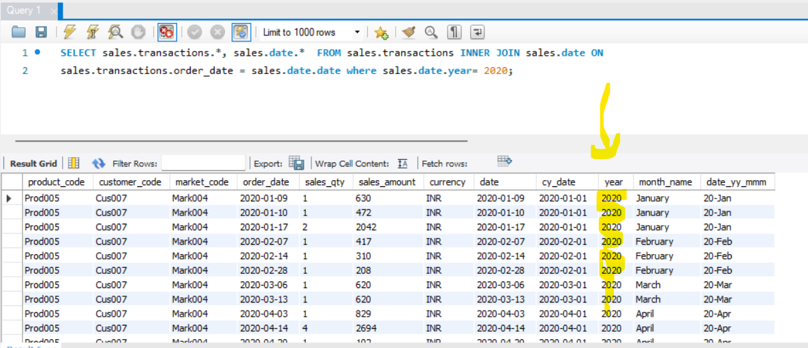
Want to print transaction only from year 2020
SELECT sales.transactions.*, sales.date.* FROM sales.transactions INNER JOIN sales.date ON sales.transactions.order_date = sales.date.date where sales.date.year= 2020;

Slide 38
Total
SELECT Sum(sales.transactions.sales_amount) FROM sales.transactions INNER JOIN sales.date ON sales.transactions.order_date = sales.date.date where sales.date.year= 2019;
SELECT Sum(sales.transactions.sales_amount) FROM sales.transactions INNER JOIN sales.date ON sales.transactions.order_date = sales.date.date where sales.date.year= 2020;

Slide 39
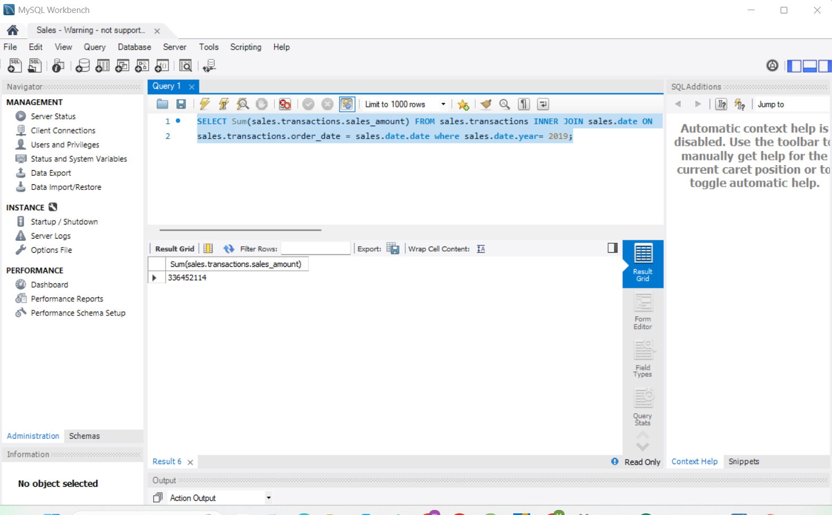

Slide 40
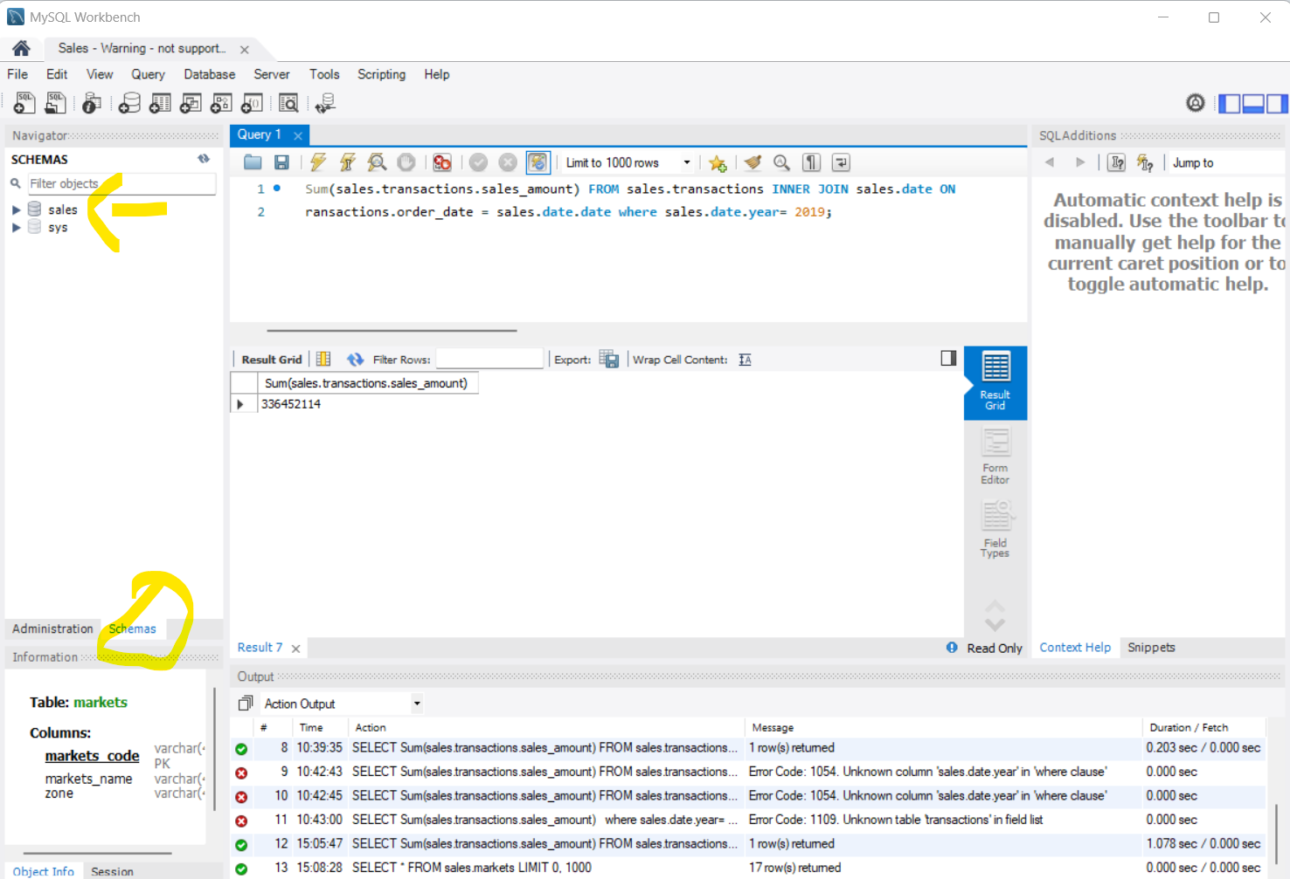
How much business you have done in Chennai
To know the market code of Chennai gotto schemas then expand table

Slide 41
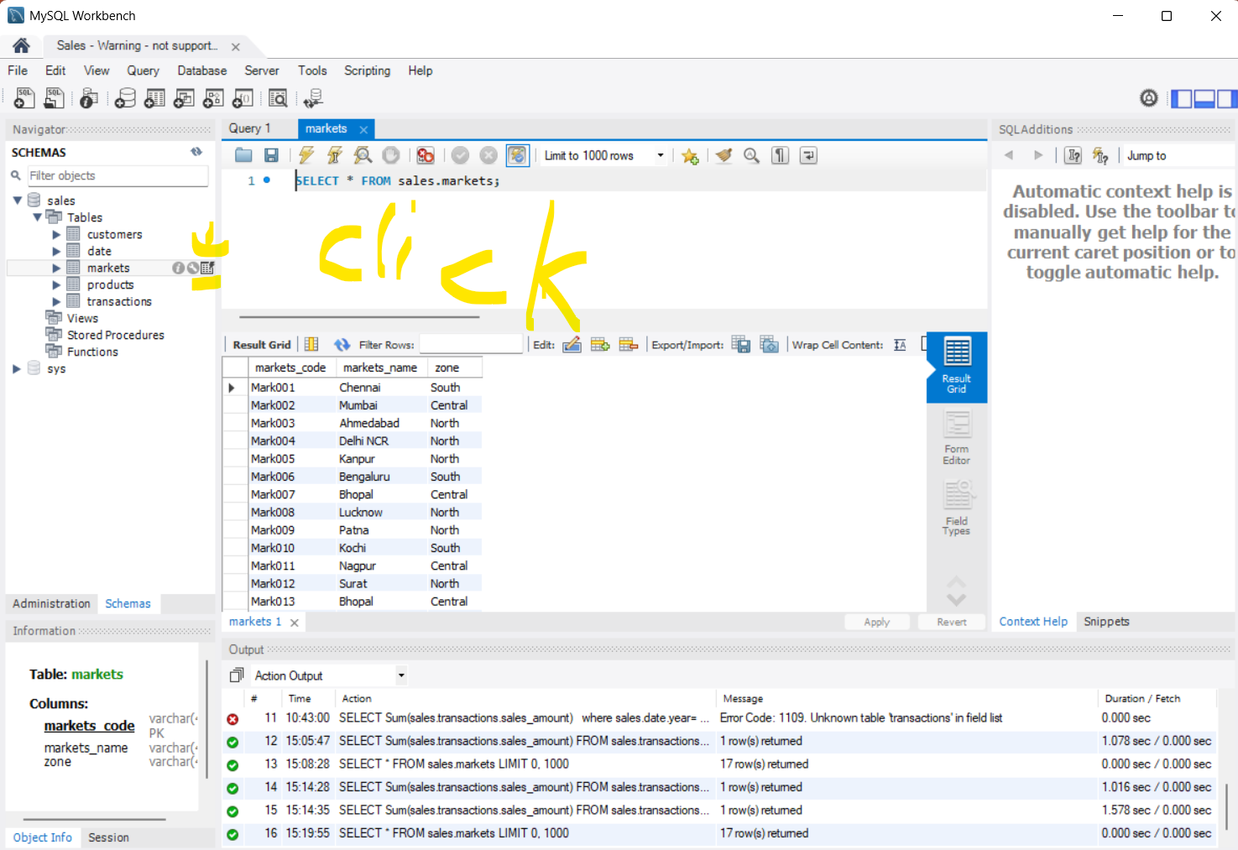
1. Goto “Markets”Click on the icon of execute table
2. Table would be executed you will find Mark001 is a code for chennai

Slide 42
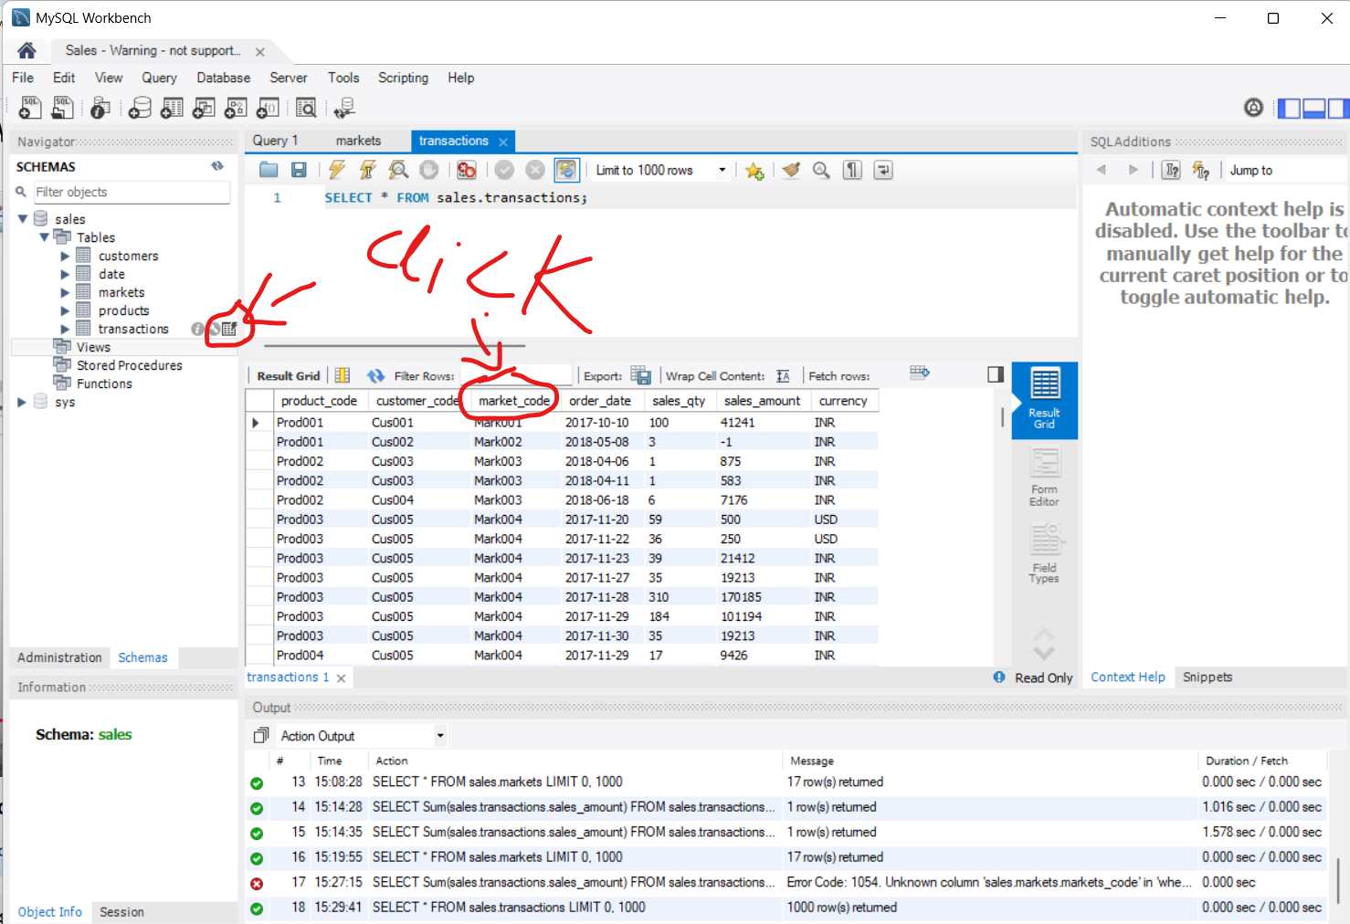
Now Write a query to find “How much business you have done in Chennai”

Slide 43
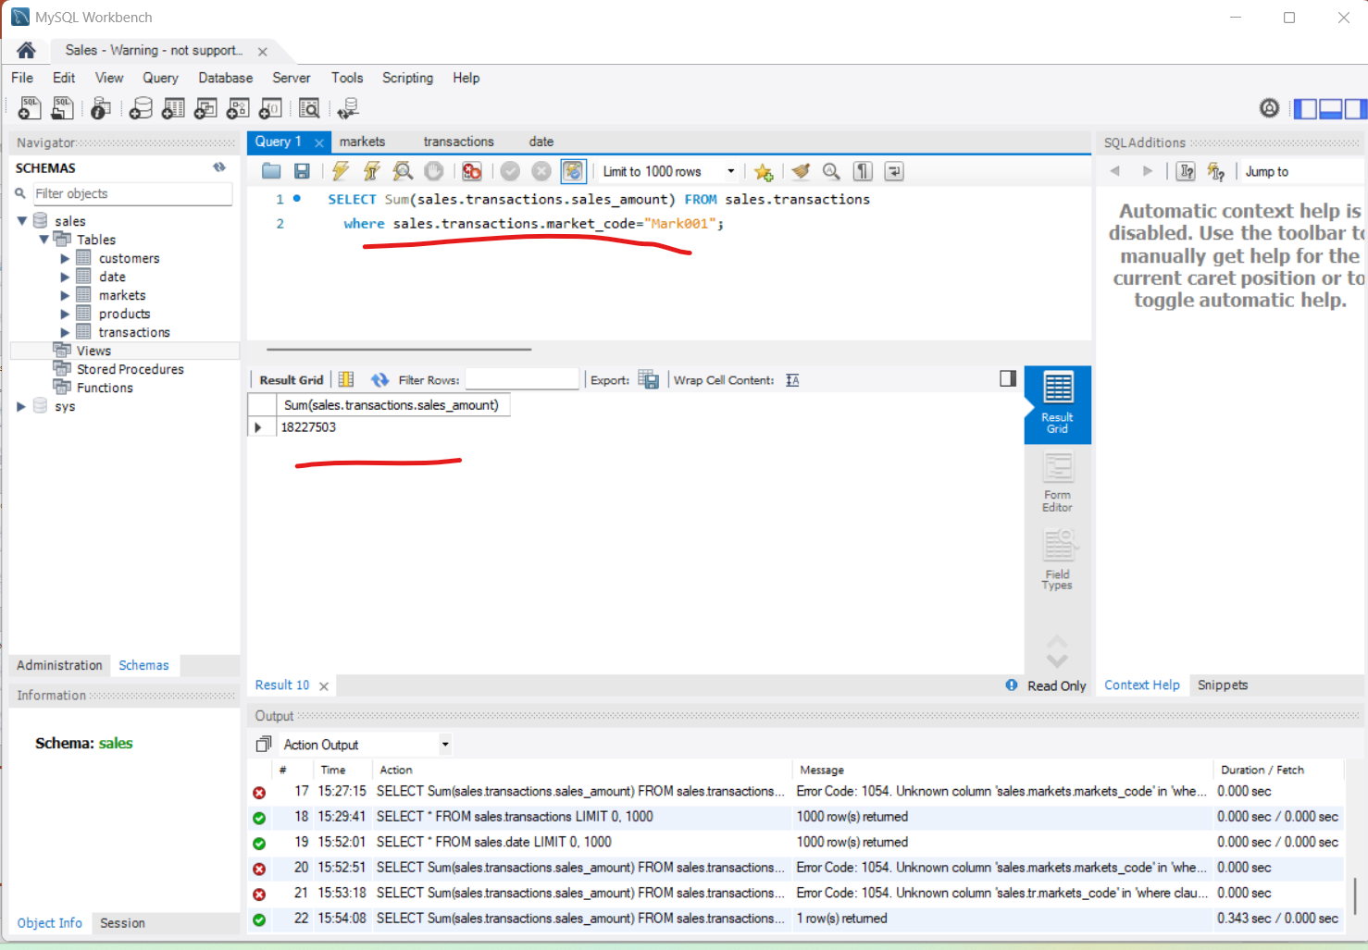
The output woulde the sum of sales in Chennai using Query “SELECT Sum(sales.transactions.sales_amount) FROM sales.transactions where sales.transactions.market_code="Mark001";”

Slide 44
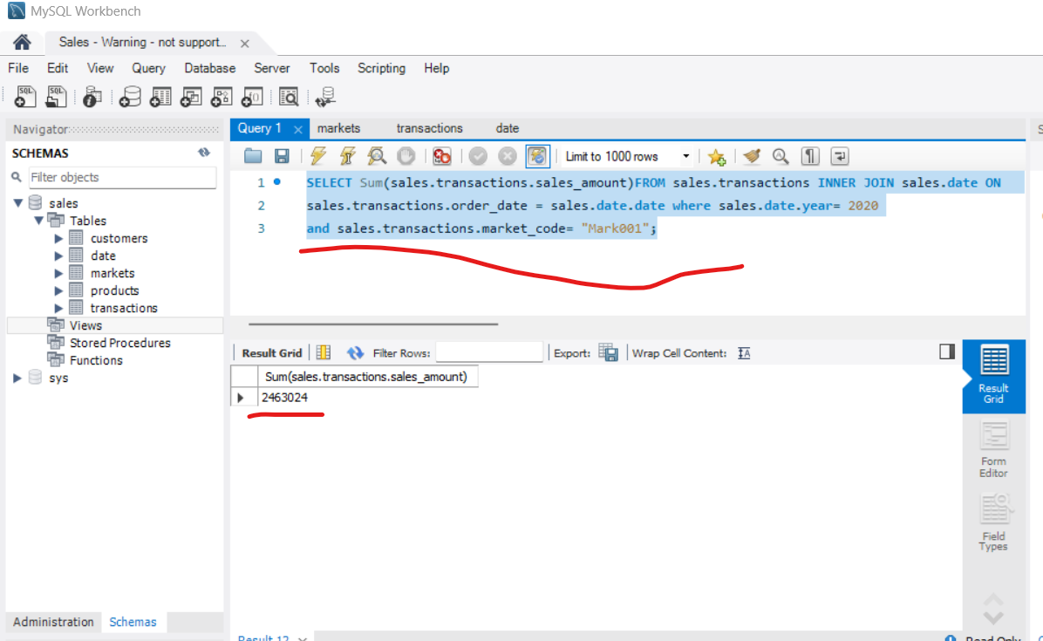
To find total sales in Chennai in year 2019 , you have to take help of inner join
Use query
“SELECT Sum(sales.transactions.sales_amount)
FROM
sales.transactions
INNER JOIN
sales.date
ON
sales.transactions.order_date = sales.date.date
where
sales.date.year= 2020
and sales.transactions.market_code= "Mark001"; ”

Slide 45
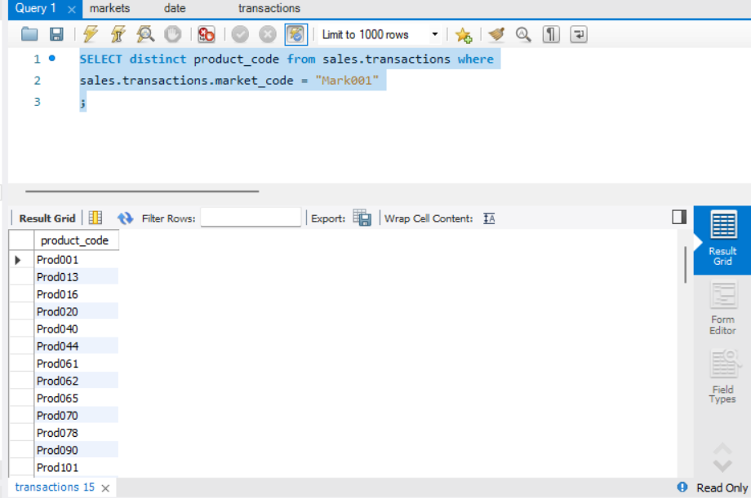
If you want to know the distinct products that you sold in Chennai
Use query
SELECT distinct product_code
From
sales.transactions
where
sales.transactions.market_code = "Mark001";

